Slide 1

Building & Mining Knowledge Graphs
(KEN4256)
Lecture 8: Link Prediction & Explainable AI

Slide 2
© 2024 by Michel Dumontier and the Institute of Data Science at Maastricht University is licensed under Attribution 4.0 International
To view a copy of this license, visit http://creativecommons.org/licenses/by/4.0/
This license requires that reusers give credit to the creator. It allows reusers to distribute, remix, adapt, and build upon the material in any medium or format, even for commercial purposes.
id: KEN4256_L8
version: 1.2024.0
created: February 9, 2019
last modified: March 26, 2024
published on: March 26, 2024

Slide 3
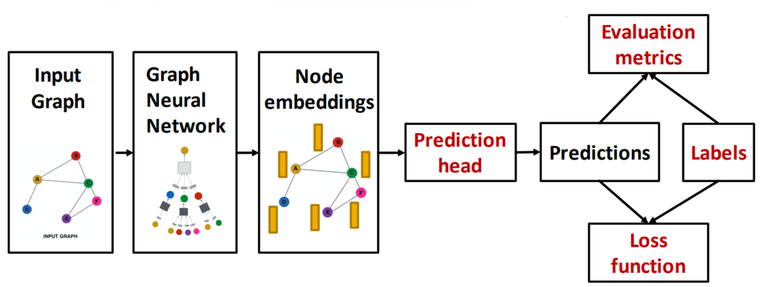
Training Framework
Forward Pass

Slide 4
Forward Pass
B
B
A
A
D
C
D
C
Compute messages
B
A
Propagate messages
D
C
B
Aggregate
A
D
C

Slide 5
Prediction & Learning
The goal of learning is to minimize the loss between predictions and labels:
B
A
B
D
C
Forward
Pass
A
D
C
Output
Probabilities
Node
Embeddings
Output
Labels
A
0.4
1
Backpropogate these errors to update the parameters
Prediction Head
&
Loss Computation
B
0.7
1
Prediction Head is typically a fully connected layer (of size embedding dimension x number of classes), followed by prediction function
C
0.91
1
D
0.1
0

Slide 6
2D Interpretation
With linear layers, this process is the same as learning embeddings such that node representations are linearly separable by a hyper-plane, i.e. binary/multi-label classification with graph input
B
Feature 2
A
D
C
Feature 1

Slide 7

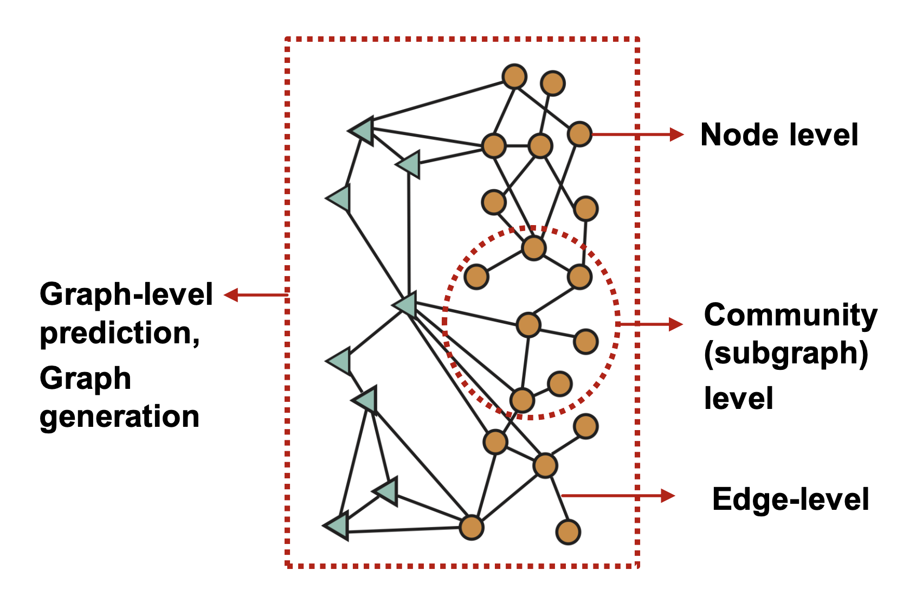
Machine Learning GNN-related Tasks
Node Classification - Predict a property of a node
e.g. categorize online users/items
Link Prediction - Predict whether there are missing links between two nodes
e.g. knowledge graph completion
Graph Prediction - Categorize different graphs
e.g. Protein function prediction
Clustering - Detects if nodes are from a community
e.g. social circle detection
Graph Generation - Create new graphs with shared structure
e.g. drug discovery

Slide 8
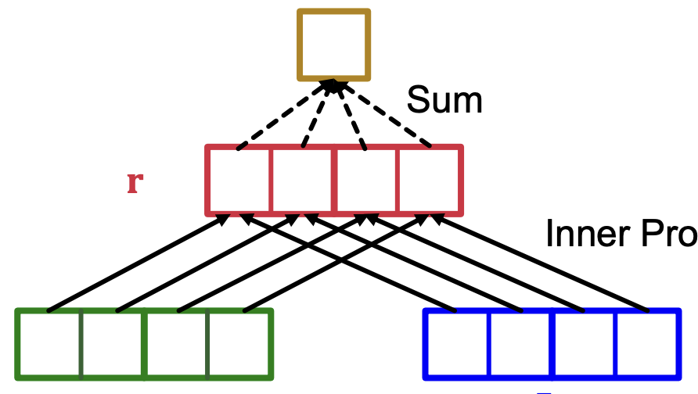
Link Prediction
If there is only one edge type, the goal is to predict missing edges
Split edges into train/validation/test sets
In each group use certain edges as always fixed and the rest for supervision
The same Encoder and Decoder architecture as before applied
Decoder output predicts the probability for existing edge
Alternatively, use Concat(u,v) passed through fully connected layer and sigmoid function
B
A
C
D
?
Edge Predictor
u
v

Slide 9




Heterogeneous Graphs
How to handle graphs with multiple types?
Captures different types of interactions between entities
Knowledge Graphs are HeteroGraphs
e.g Google Knowledge Graph , Amazon Product Graph, Facebook Graph API , IBM Watson, Project Hanover/Literome, Project Hanover/Literome
r₂
B
r₁
r₁
A
D
r₃
C

Slide 10
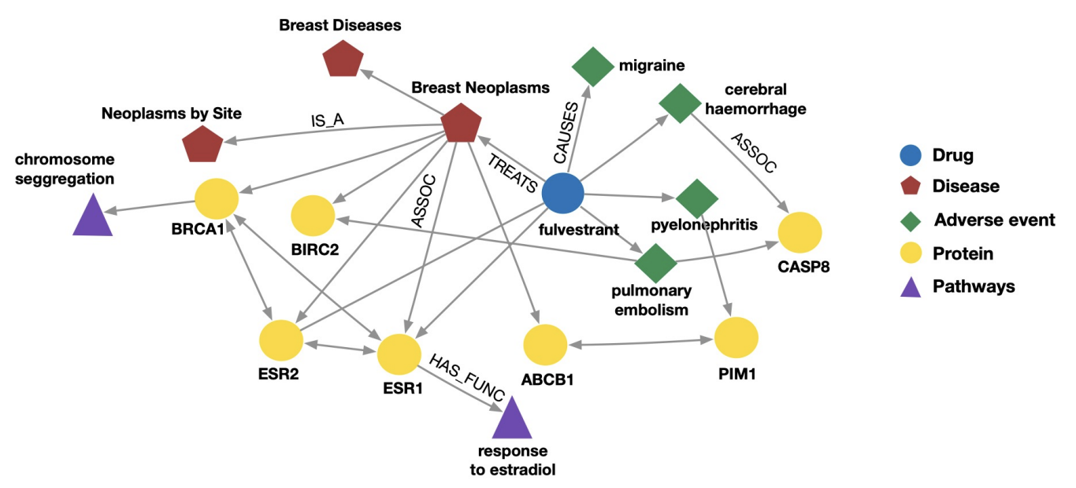
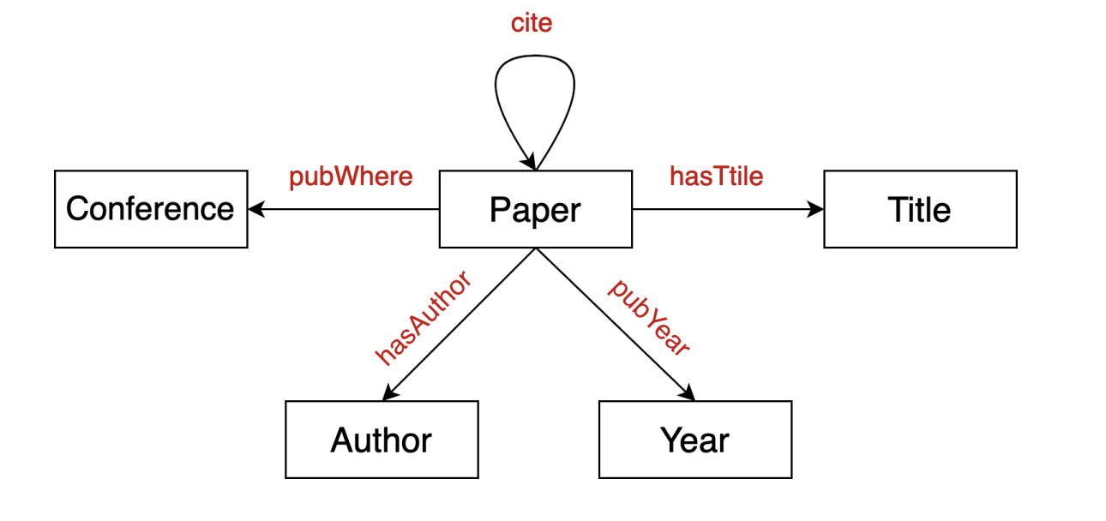
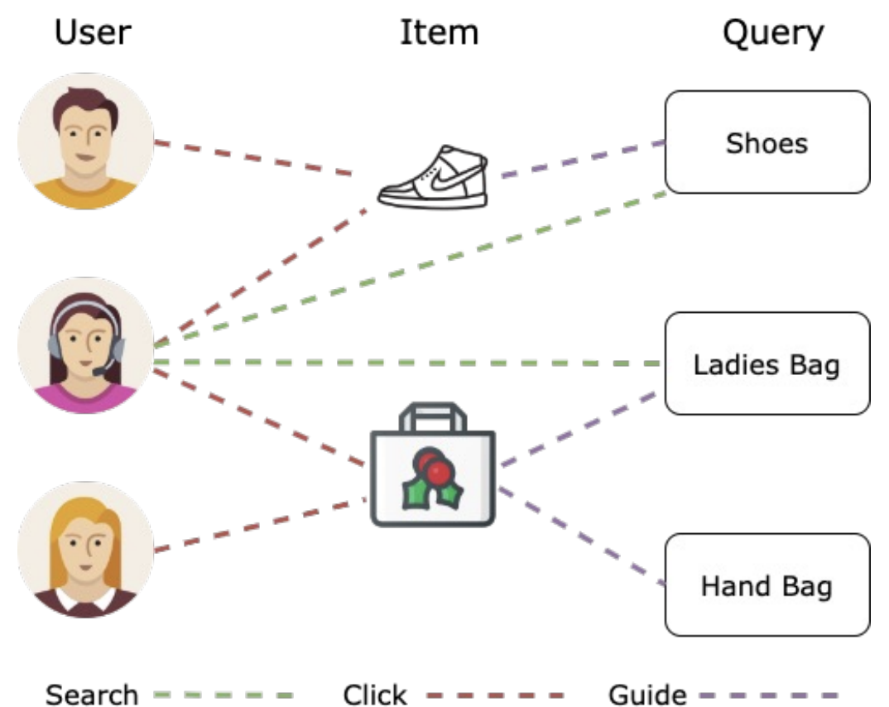
Heterogeneous Graphs
Many real life applications, e.g. Biomedical Knowledge Graphs, Events Graphs, Academic Graphs
More expensive (computation, storage), more complex implementation

Slide 11
Relational GCN
Extension of Graph Convolutional Networks to handle heterogeneous graphs with multiple edge and relation types
Key Idea: Use different neural network weights for different relation types
Neural weights for relation r₂
Target Node
Computation Graph
r₂
B
B
r₁
r₁
Agg
A
A
D
r₃
C
D
Neural weights for relation r₁

Slide 12
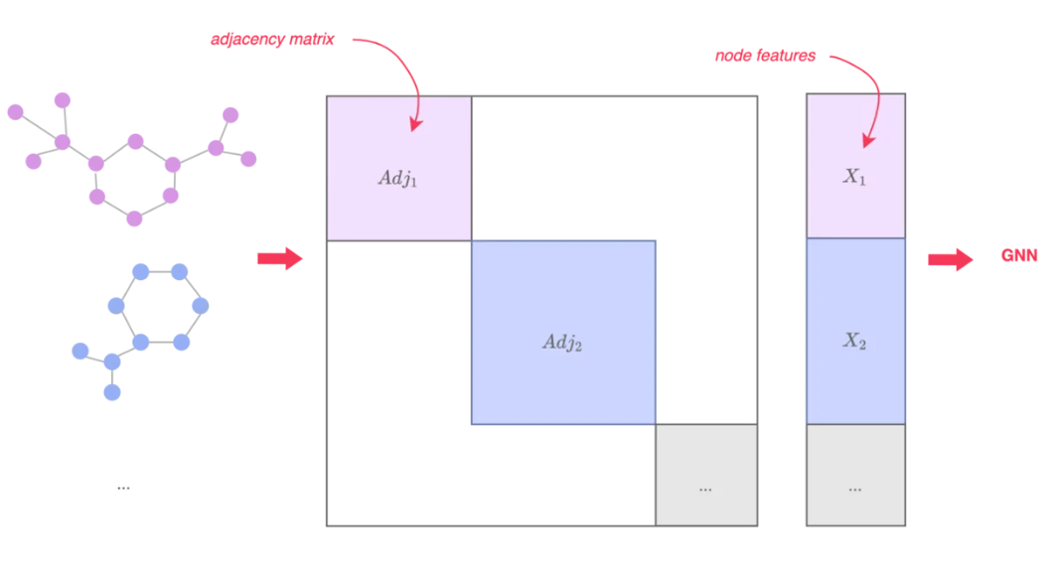
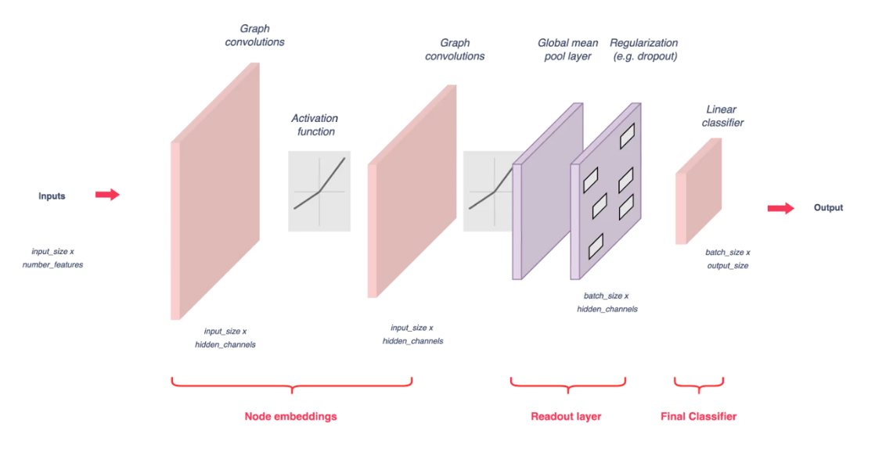
Graph-level Prediction
Adjacency matrix
node
features
To perform graph-level prediction, we need to learn from many graphs
Same GNN methodology can be utilized with the following modifications
Stack adjacent matrices in a diagonal manner leading to a large graph with isolated subgraphs
Concatenate node features
GNN
input
output
https://blog.dataiku.com/graph-neural-networks-part-three

Slide 13
Explainable AI
Explain how model makes prediction, without necessarily understanding the inner mechanics
Model-agnostic (need only outputs) vs model specific
Feature mask
Edge mask
Node mask
1
0.9
1
0.7
0.9
0.9
0.7
0.1
0
0.0
1
X
r₂
B
r₁
r₁
GNN
A
Predictions
D
r₃
C
Adj

Slide 14
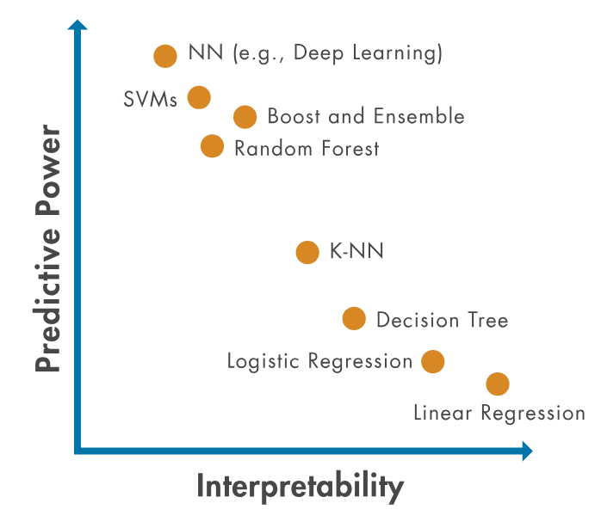
Explainable AI
Explain how model makes prediction, without necessarily understanding the inner mechanics
Model-agnostic (need only outputs) vs model specific
Some models are interpretable by nature
e.g. decision tree
https://nl.mathworks.com/discovery/interpretability.html

Slide 15
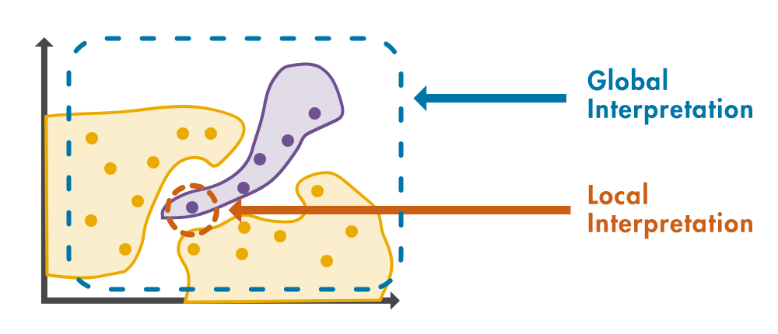
Explainable AI
Explain how model makes prediction, without necessarily understanding the inner mechanics
Some models are interpretable by nature
e.g. decision tree
Instance (local) vs Model (global)
Explanation at the level of an individual prediction or the most influential parameters from the whole model
Global
Interpretation
Local
Interpretation

Slide 16
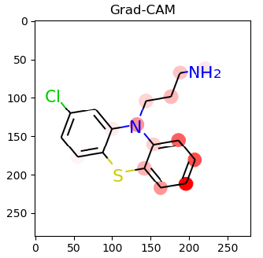
GNN Explanations
Instance Level
Gradient based, rely on gradients to determine input importance , e.g. CAM, Grad-CAM, Buided BP
https://github.com/ndey96/GCNN-Explainability

Slide 17
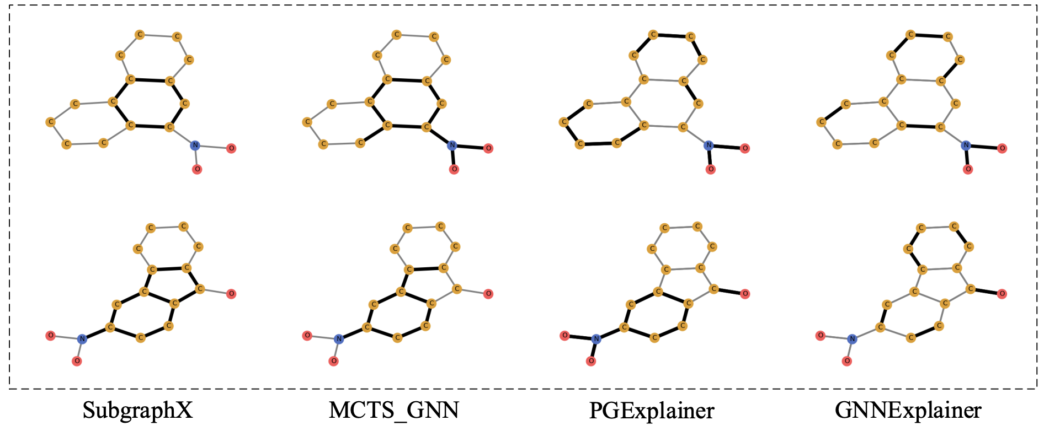
GNN Explanations
Instance Level
Gradient based, rely on gradients to determine input importance , e.g. CAM, Grad-CAM, Buided BP
Feature based, rely on features and interpolation to determine input importance, e.g. GraphMask, SubgraphX, GNNExplainer
https://arxiv.org/pdf/2102.05152.pdf

Slide 18
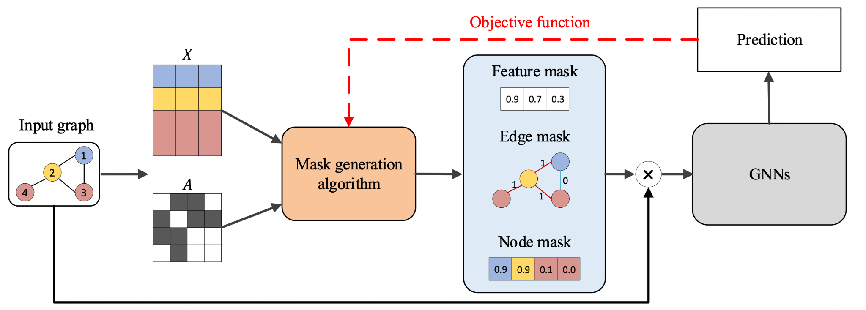
GNN Explanations
Instance Level
Gradient based, rely on gradients to determine input importance , e.g. CAM, Grad-CAM, Buided BP
Feature based, rely on features and interpolation to determine input importance, e.g. GraphMask, SubgraphX, GNNExplainer
Perturbation based, examine output variations w.r.t. Input perturbations
Yan et al, “Explainability in GNN: A Taxonomic Survey”

Slide 19
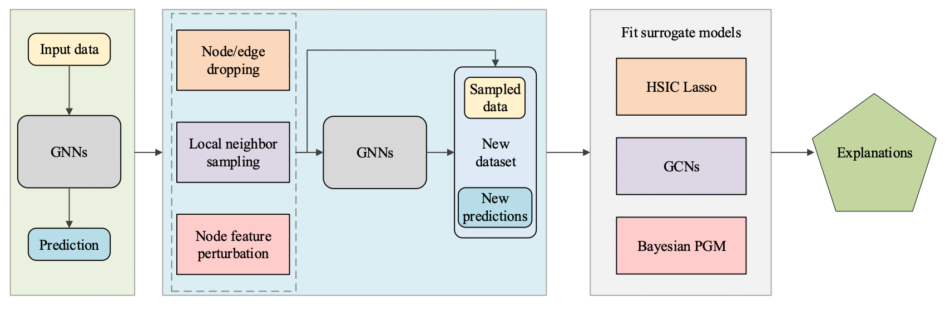
GNN Explanations
Instance Level
Gradient based, rely on gradients to determine input importance , e.g. CAM, Grad-CAM, Buided BP
Feature based, rely on features and interpolation to determine input importance, e.g. GraphMask, SubgraphX, GNNExplainer
Perturbation based, examine output variations w.r.t. Input perturbations
Surrogate Model, train a simpler, interpretable model to approximate predictions, e.g. GraphLIME
Yan et al, “Explainability in GNN: A Taxonomic Survey”

Slide 20
Saliency Map
Saliency Maps originates from computer vision-related literature and is a pixel attribution method, which highlights the pixels that were relevant for a certain image classification by a neural network
The idea is to compute the gradients of the output with respect to the input
Then, the attribution value along the ith dimension for an input x∈R^n is defined as the absolute value of the gradient:

Slide 21
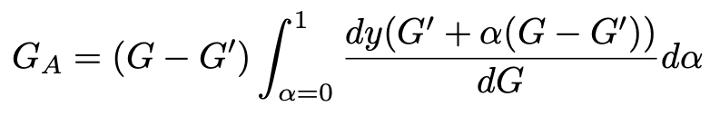
Integrated Gradients
Saliency Maps are not well localized, no guarantees, and unstable w.r.t. Small changes and sensitivity in input
Extension of Saliency Maps, by integrating along a path from an all masked (empty) graph to the target graph
In essence, average saliency maps over many graph topographies
Leneling et al, “Evaluating Attributions for GNNs”

Slide 22
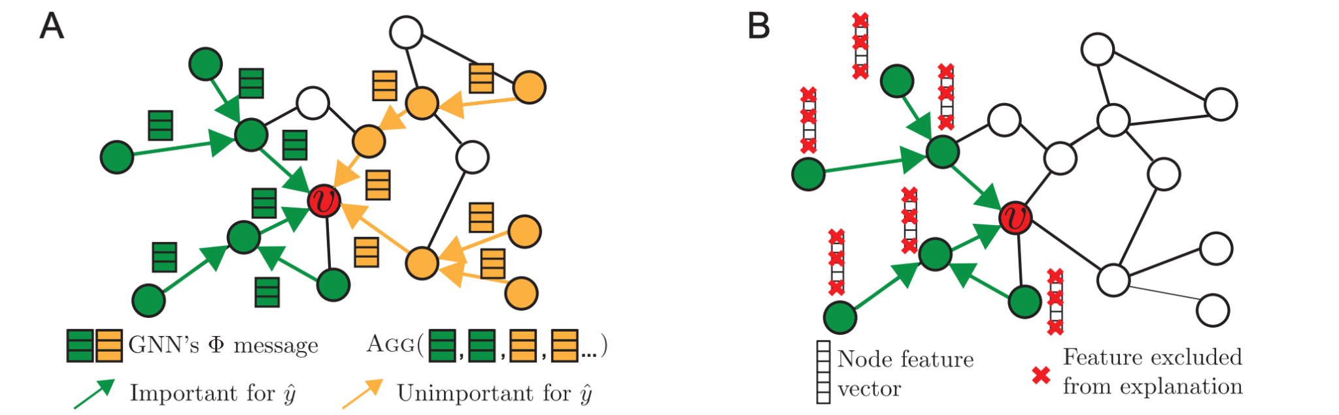
GNNExplainer
If the graphs are small, saliency maps work well
GNNExplainer, treats the problem of finding masks as an optimization problem, subject to following regularizations:
Masks should not change original predictions
Masks should be as small and sparse as possible
Ying et al, “GNN Explainer: Generating Explanations for GNNs”
Notes:
Both relevant pars (A) as well as features (B)

Slide 23
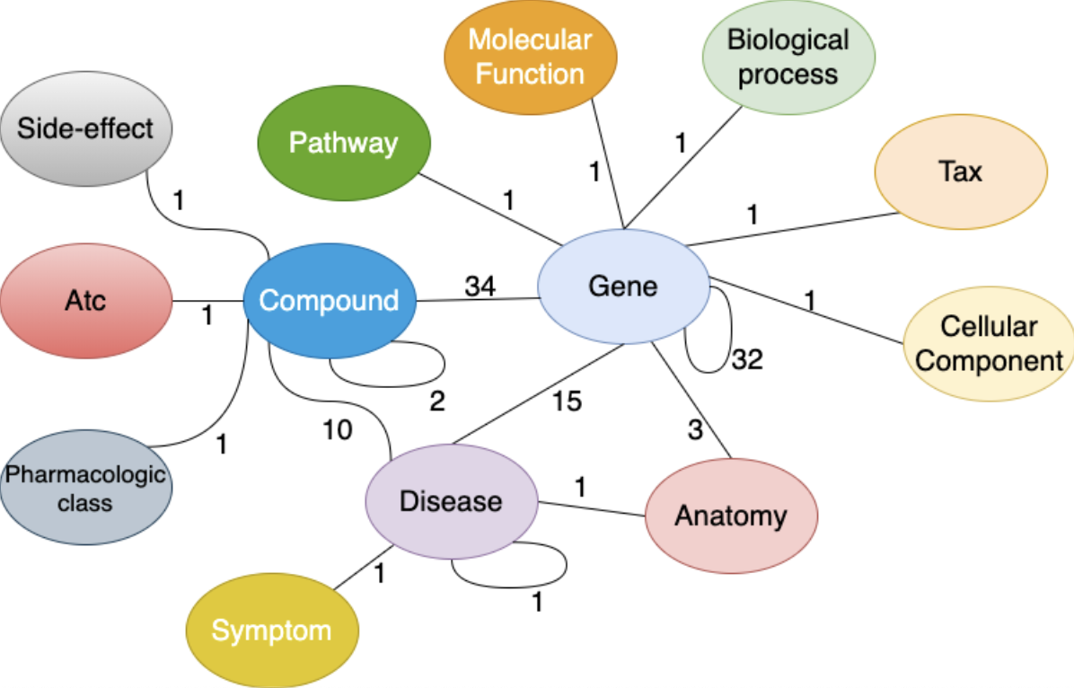
Another Example of Heterogeneous Graph
Drug Repurposing aims to find new potential uses for an existing drug and is often modeled as a link prediction problem where the link between the candidate drug and the target disease is aimed to be predicted:
(Compound, treats, Disease)
Interconnections among entities in DRKG.
Loech J, Yang Y, Ekmei P, Dumontier M, and Celebi R, “Explaining Graph Neural Network Predictions for Drug Repurposing”, SWAT4HCLS 2024

Slide 24
Methodology
Use Graph Neural Networks to capture semantics, graph structure and relationships between nodes
Apply Saliency Maps on predictions made by GNNs to identify relevant nodes for a specific prediction; this provides valuable insights into the graph's topology and highlights the most important components
Saliency Maps assign a score to each node in the network, which can be used to rank paths involving genes, pathways, diseases, and compounds
Loech J, Yang Y, Ekmei P, Dumontier M, and Celebi R, “Explaining Graph Neural Network Predictions for Drug Repurposing”, SWAT4HCLS 2024

Slide 25
Recal: Training Framework
Forward Pass

Slide 26



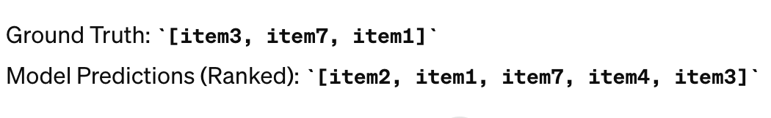

Evaluation Metrics
Hits@K
Counts the number of hits (correct predictions) within the top-K recommendations.
A higher Hits@K indicates better accuracy in predicting relevant items
MR (Mean Rank)
Calculates the average position of correct predictions in the ranked order
Lower MR values signify better model performance as correct predictions are closer to the top
A float number greater than 0
MRR (Mean Reciprocal Rank)
Evaluates the average reciprocal rank of correct predictions.
Closer to 1 is better, between 0 and 1
N =3

Slide 27
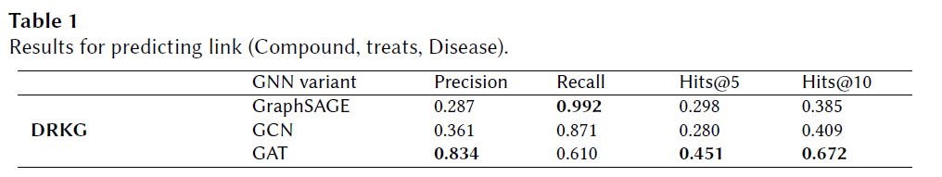
Results: Graph Neural Networks
GAT achieves a Hits@5 score of 0.451 and a Hits@10 score of 0.672
GraphSAGE achieves a high Recall Rate of 0.992
→ High emphasis on Recall in Drug Repurposing scenarios to minimize falsely predicted links between drugs and diseases:

Slide 28
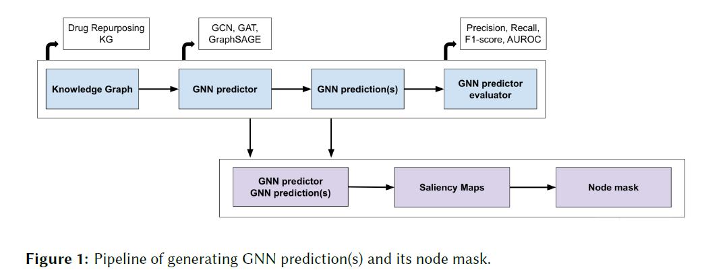
Explaining GNN Predictions for Drug Repurposing
The proposed framework takes as input any prediction of a trained GNN-based link prediction model and returns an explanation in the form of a small subgraph of the input graph
To return an explanation in the form of a small subgraph, we employed Saliency Maps, which is an attribution gradient-based method capable of attributing an importance score to the nodes and edges from the input graph via backpropagation
Loech J, Yang Y, Ekmei P, Dumontier M, and Celebi R, “Explaining Graph Neural Network Predictions for Drug Repurposing”, SWAT4HCLS 2024

Slide 29

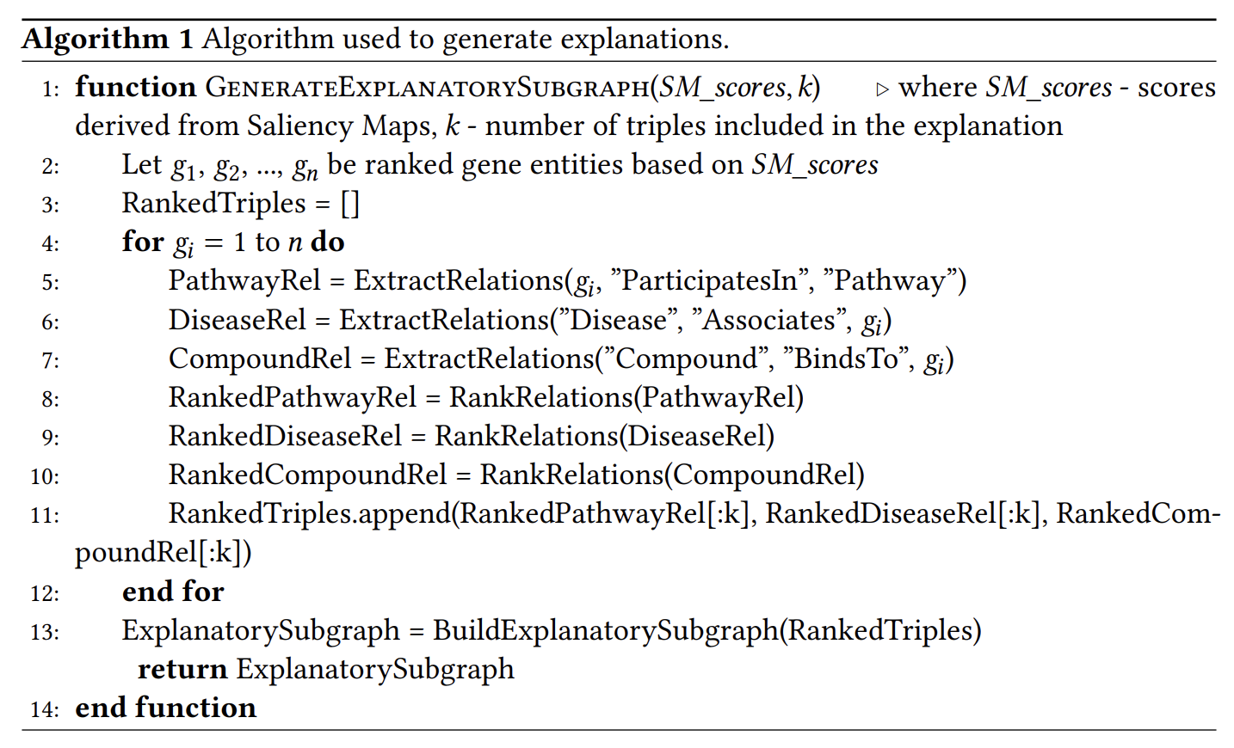
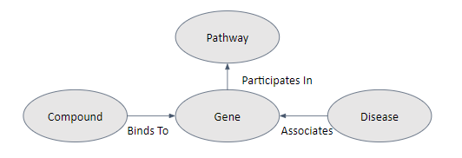

Slide 30
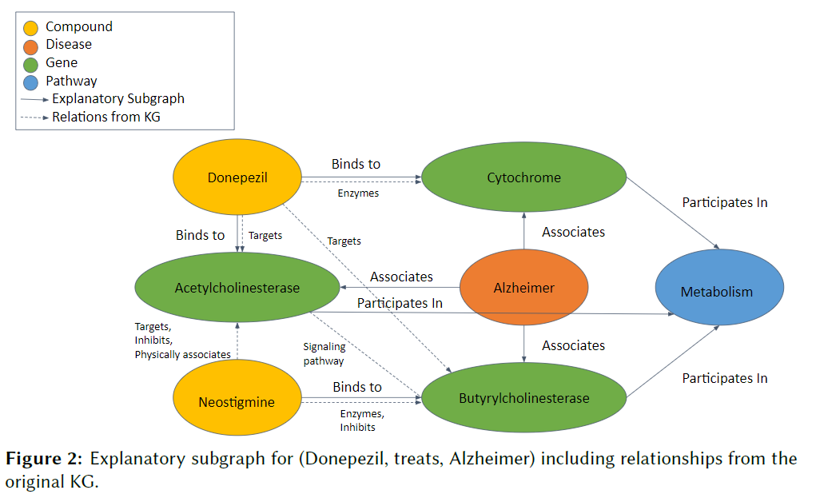
Use Case: Donepezil treats Alzheimer
The primary goal of Alzheimer's drugs, including Donepezil, is to maintain elevated acetylcholine (ACh) levels, thereby compensating for the loss of functioning cholinergic brain cells
Figure 2 emphasizes the crucial role of Donepezil binding to acetylcholinesterase (AChE) and butyrylcholinesterase (BChE)

Slide 31
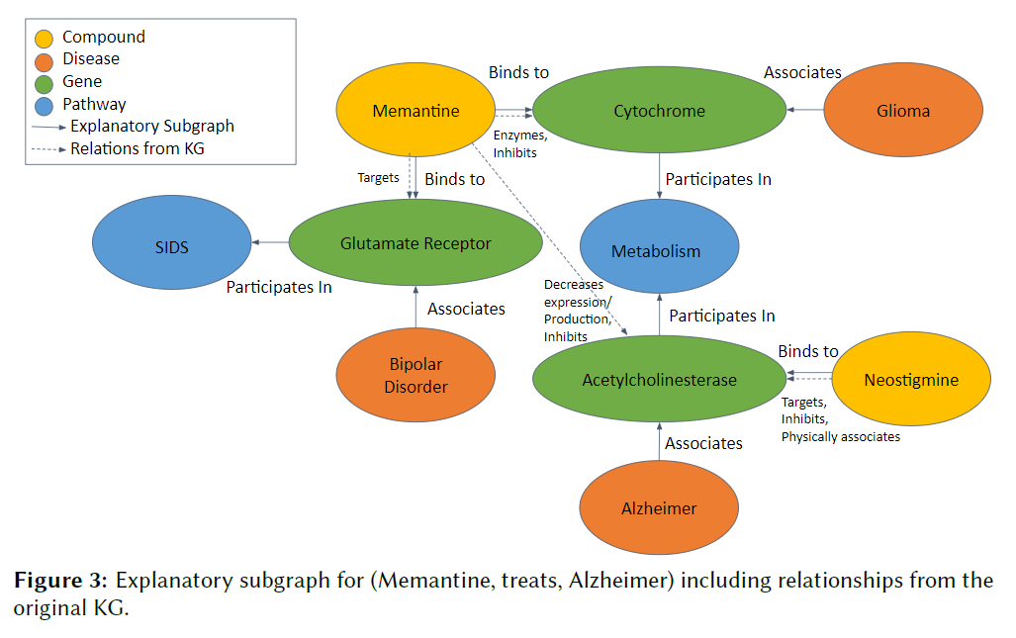
Use Case: Memantine treats Alzheimer
Memantine, commonly prescribed for moderate to severe Alzheimer's disease, is believed to help prevent excess levels of the substance glutamate from damaging the brain
Thus, according to our explainability framework and existing literature, important genes associated with Memantine include glutamate receptor and acetylcholinesterase

